Slide 1



Power BI Project
View in Power BI
Last data refresh:
12/28/2023 1:10:53 PM UTC
Downloaded at:
12/28/2023 1:16:11 PM UTC

Slide 2
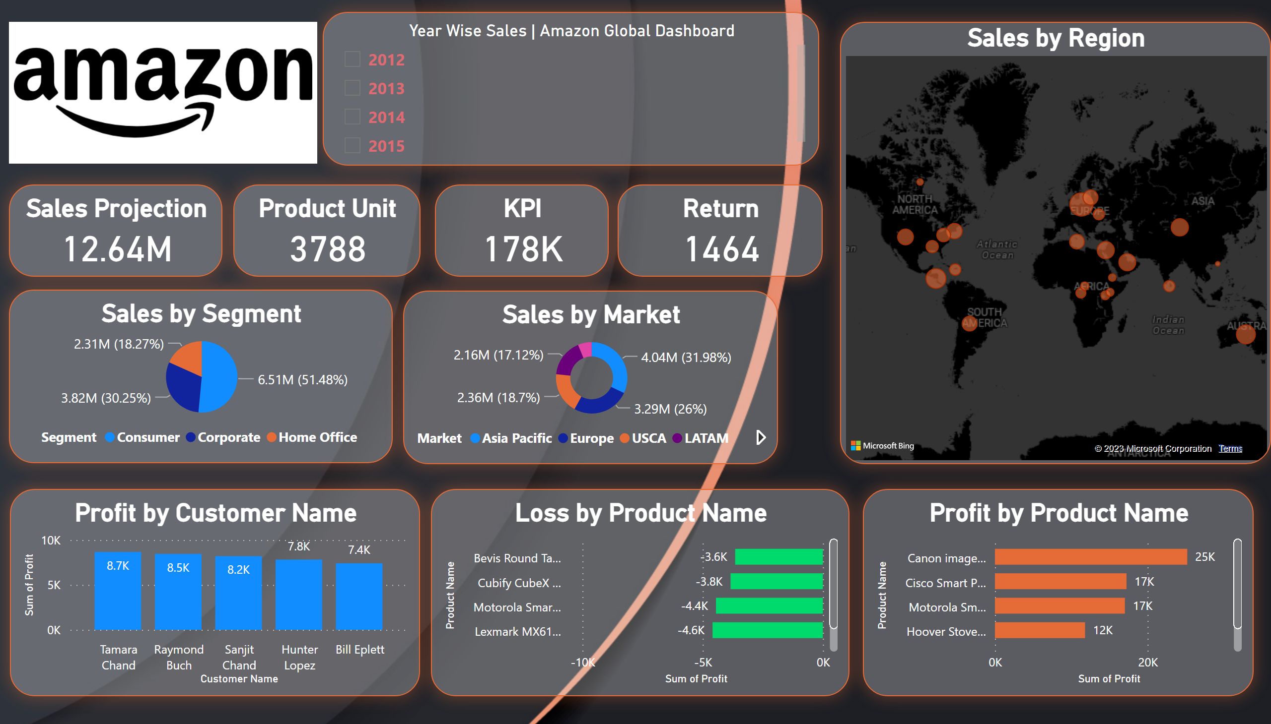
Page 1
Notes:
Year Wise Sales | Amazon Global Dashboard
No alt text provided
Sales Projection
No alt text provided
image
No alt text provided
Product Unit
No alt text provided
KPI
No alt text provided
Return
No alt text provided
Sales by Segment
No alt text provided
Sales by Market
No alt text provided
Profit by Customer Name
No alt text provided
Loss by Product Name
No alt text provided
Profit by Product Name
No alt text provided
Sales by Region
No alt text provided

